Slide 1

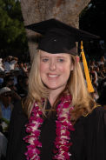
Mrs. Fay
Room 8
2019-2020

Slide 2

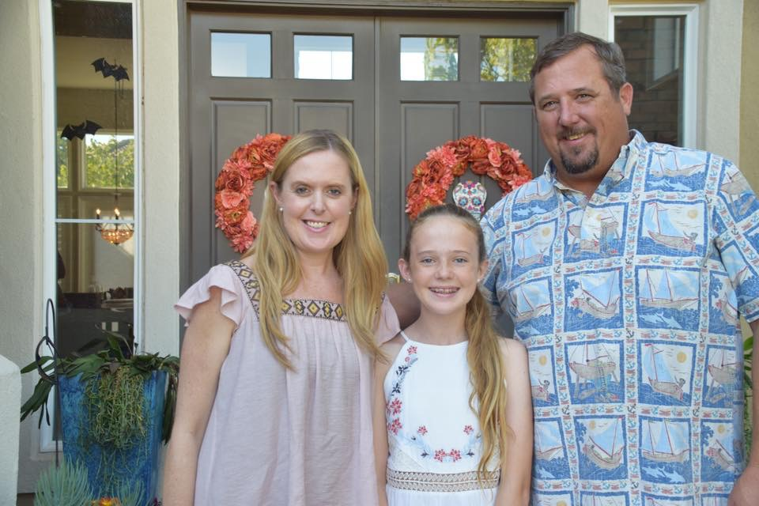
Originally from Santa Barbara
21 years teaching, 20 at Cornerstone
Married 15 years
Mom to Meara, 7th grader
Love yoga, cooking & being a dance mom
Happy to be part of the Cornerstone family!

Slide 3


Parents and teachers work together to provide the best educational environment possible – WE ARE ALL IN!
We want to create independent learners who are intrinsically motivated to succeed.
We are here to help children succeed and capture the love of learning.
Flexibility is essential as we work together.
We are acting as facilitators guiding the child- we must let them do their work.
Cell phones should be on vibrate mode while in the class.
If you must answer a call then please take it outside.
Please leave perfume/cologne at home.
Confidentiality is REQUIRED!

Slide 4

Language Arts
Themes for Learning and Understanding
1.Getting to Know Us
2.Our Community
3.Changes Over Time
4.Animals Everywhere
5.Figure It Out
6.Together We Can
  Our district is using the Wonders (McGraw Hill) English Language Arts program.
  We will provide students with grade level standards-based reading skills such as knowledge of letter sounds, short and long vowels, diphthongs, digraphs, blends, compound words, and contractions.
  Through the stories presented, the students will predict, infer, and use comprehension skills to dissect stories. They will be practicing correct sequencing of sentences and grammar skills, using syntax. Along with this reading program, we will use a variety of other reading sources in order to meet the needs of all children.
  Science, Social Studies and Health concepts will be integrated into each unit. The Science Lab will be used in order to safely perform experiments and complete projects to reach all types of learners.

Slide 5



  There is ample opportunity for writing. Each day the students write in a journal. We begin with simple sentences, and then move into writing short paragraphs, focusing on one topic.
  We also do interactive writing, shared writing, friendly letters and cross-curricular writing.
  Writer’s Workshop will continue this year, focusing on narratives, opinion writing, and informational writing.
  Handwriting will be practiced daily, as it is a state standard.

Slide 6



Math In Focus/CGI
Math In Focus will present challenging grade level concepts.
Weekly CGI practice and word problems will challenge students to explain their thinking and to show different ways to solve problems.
Counting, word problems, and algebraic thinking are just a few concepts taught.
Addition and subtraction are taught in many different ways in order to foster a deep understanding of the concepts.
We will also work on telling time, counting money and geometry.

Slide 7

Common core state standards will be assessed on our report card this year.

Slide 8

Differentiated instruction is meeting the needs of all learners.
Small group instruction makes this possible.
We will have different reading groups that are working on the skills necessary to be most successful and master the state standards. The group work will challenge the child but not frustrate him/her.
You will see: different books being read, different writing assignments, different expectations, and growth in your child.
We also differentiate instruction in math small groups, with CGI and with the help of our RTI program.

Slide 9



Art
Trek

Slide 10




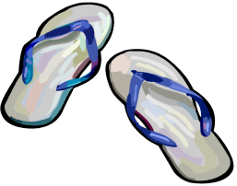

With Mrs. Winbauer and Coach Jessie, students will learn about body structure, healthy eating, and good sportsmanship.
Kids will need to wear comfortable clothes and shoes EVERY day so that we can keep active.
If you are a TP on PE days, be prepared to get active with the
kids and to assist with PE lessons!

Slide 11



Daily interaction with books allows children time to explore and LOVE reading.
Books may also be brought in from home. Please have your name on any book you bring in for quiet reading.
Please let me know if you need to borrow ANY books!

Slide 12




Students will get a handmade birthday book to take home.
We ask that you do not bring any food or drinks.
You do have the option to donate a book to our class library.

Slide 13


Every week your child will have a classroom job. The job will help facilitate learning and promote responsibility.

Slide 14

Please be on time for your shift!
TP1 - 8:10-11:50
TP2 – 8:30-12:10
TP 3- 11:40-3
Shift times are different on early dismissal Mondays and minimum days.
Please remember to sign in. The sign in is located on the window.
Please read the instructions on the clipboard carefully.
Familiarize yourself with directions for checking in homework, grading papers and stuffing HW folders – posted on TP work table and also on Edlio.
Always ask me for help if my directions do not seem clear.
See list of extra jobs to do if you have down time.

Slide 15
Things to Remember…
Paper cutters in classroom, office and MPR workroom
Electric stapler for packets
Electric 3-hole punch in office
Use electric pencil sharpener in office for big jobs; don’t sharpen pencils while I’m teaching
Make sure we are stocked with extra pencils each morning
Don’t talk to kids when I’m teaching
When hanging student work, use minimal amount of tape on BACK only; use stapler or push pins on bulletin boards
Use clear packing tape to attach butcher paper to door
Always use “first grade” printing!

Slide 16

Communication
Classroom is closed until 8:30 – this is precious planning time!
Please don’t expect to conference with me during your shift.
Email is my preferred method of communication.
If you need to talk face-to-face, please ask for an appointment.
You do not need to send me daily notes about your child’s lunch preference or pick-up schedule. We expect first graders to know what they are eating and where they are going. 9 times out of 10, they do, and we will help them sort it out if they don’t!

Slide 17



Mrs. Fay Wears
Many Hats!
Please help the sub while I am away, but be assured that I will leave detailed instructions for her or him, so that they can lead the class in my absence.

Slide 18


Playground Duty is very important.
Our main priority is the safety of our children.
Please stay in your designated spot.
Don’t be afraid to say NO!
Please use the appropriate forms to fill out for behavior reports.

Slide 19

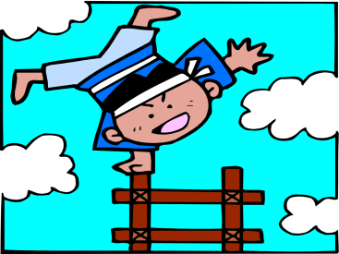

Please walk the children down to the snack tables. One person should walk in front so the children do not run ahead.
For snack, children MUST sit for 5 minutes. If they finish early or do not have a snack they must still wait for 5 minutes.
For lunch, children MUST sit for 10 minutes.
Once finished, children must put his/her lunch away in the designated area, throw trash away, and wash their hands with the wipes.

Slide 20


During snack and lunch time children with nut allergies must sit at the nut free table. Do not allow children to sit at this table if they have any food with nuts or nut traces in it. Please review this at home with your child. Let me know immediately if your child has a nut or other allergy.

Slide 21

In class, I use the clip system to monitor behavior.
Each child always starts the day on “Good Job”.
A clip is moved down when a poor choice is made.
A clip may be moved back up if the child shows to be improving his/her behavior.
A child may move up to “Super Star” if he/she is showing outstanding citizenship.
Students will bring home a report of their behavior each day – please reinforce at home!
We are working on being RESPECTFUL, RESPONSIBLE and READY TO LEARN!

Slide 22


Never take your child without properly checking him/her out!

Slide 23

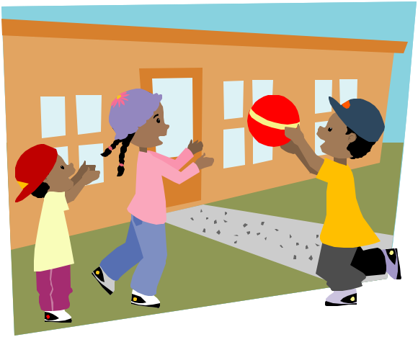

Attendance is imperative!
Plan your vacations around school holidays.
…..Please keep your child at home if he/she is sick. They should be fever and vomit-free for 24 hours before returning!

Slide 24


Homework is an extension of the curriculum and is to be done at home.
Weekly homework assignments are all online this year.
Homework is considered late if not turned in on Friday.

Slide 25
Homework Folders
Weekly assignments include a reading log, spelling word study activities and math practice.
We have a monthly Homework Menu of optional activities for kids who need more.
Online homework options will include RAZ Kids, IXL and the Wonders app.
Check folders frequently for additional assignments, notes from me.
Bring folders to school EVERY day.
Clean out old material from folders each week.

Slide 26


Each child will have his or her week to be the star student.
This is a special and fun time to get to know everyone.
Students may bring 1 item to share each day during the week.
They may also bring items for our Estimation Jar.
You will get the papers to take home a week before your child is the star.

Slide 27

Each week your child will need to do an oral language sharing assignment.
The presentation may not be more than 2 minutes long.
It is essential that your child prepares for this at home.
Note cards with small pictures or phrases can be helpful IF your child can read them!
Please practice:
  Speaking loud and clear
  Standing up straight
  Making eye contact

Slide 28

C S AC
Posture and eye contact | Stands up straight, looks relaxed and confident. Establishes eye contact with everyone in the room. | Sometimes stands up straight and establishes eye contact with almost everyone in the room. | Does not stand up straight and establishes little or no eye contact.
Voice | Voice is clear and loud. Speaks with confidence. | Voice is sometimes clear and loud. Speaks with some confidence. | Voice is hard to hear by the audience. Lacks confidence. Acts silly or inappropriately.
Content | Describes people, places, things and events with relevant details, expressing ideas and feelings clearly. | Student gives some good information but more details would help. | Student does not address the topic. More information needed.
Preparedness | Student is well prepared, on time, and ready to present. | Student presents but does not seem well prepared. | No share.
Time Limit | Presentation is 2 minutes or less. |  | Presentation exceeds time limit.

Slide 29

Thank you for being here and for all your hard work!!

Slide 30



